Slide 1
Category review: Chips
10 October 2022
Retail Analytics
Brand note: If client logo is not required, use alternate title page layout right click slide thumbnail > Layout > Title

Slide 2
Notes:
To view Privacy video explaining how important data privacy is to Quantium, please click here: https://www.youtube.com/watch?v=Zq1QDAkoRzU
or here Q:\Company Reference\Brand & Design\Brand videos\Q Privacy.mp4
At Quantium, we believe that data is the behavioural footprint of humanity and that it has to be treated with the utmost care and responsibility.
Histories, attitudes, indeed lives are stored within it in ways that aren’t always apparent – and that’s what makes its potential so powerful.
To work with it responsibly, sensitively, we set ourselves the highest data privacy protection and governance standards.
We have spent 17 years perfecting privacy-by-design and secure-by-design principles. Central to this is not holding any personally identifiable information about people –
we neither receive it, and put the necessary protections in place to be unable to decipher it.
Every aspect of handling data is safeguarded: from its de-identification, to its encryption – data security is paramount and of the highest grade.
We pride ourselves on gaining the trust of iconic organisations around the world through years of securely working with their data,
and in turn the trust that builds with their stakeholders.

Slide 3
Executive summary
01
Task 1
Here you will include your high-level findings and any key callouts for task 1
Increase in sales occurs in the lead up to Christmas then dip on Christmas due to shops being closed.
Sales have mainly been due to Budget - older families, Mainstream - young singles/couples, and Mainstream- retirees shoppers.
Due to the fact that mainstream young singles/couples and retirees are more than other buyers they tend to spend more on chips.
An indicative of impulse buying behavior is seen where mainstream, mid-age, young singles and couples pay more per packet of chips.
Mainstream young singles and couples are 23% more likely to purchase Tyrrells chips compared to the of the population.
02
Task 2
Here you will include your high-level findings and any key callouts for task 2
There is a significant increase in sales as shown from the trials since total number of customers in the trial period for the trial store is significantly higher than the control store for two out of three months, which indicates a positive trial effect.
We've found control stores 233, 155, 237 for trial stores 77, 86 and 88 respectively.
The results for trial stores 77 and 88 during the trial period show a significant difference in at least two of the three trial months but this is not the case for trial store 86.

Slide 4
01
Category

Slide 5
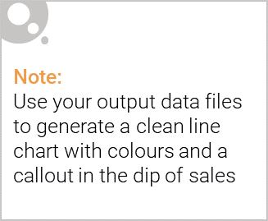
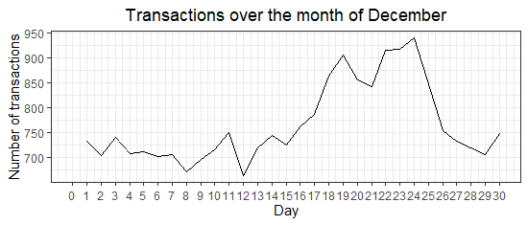
Increase in sales occurs in the lead up to Christmas then dip on Christmas due to shops being closed.

Slide 6

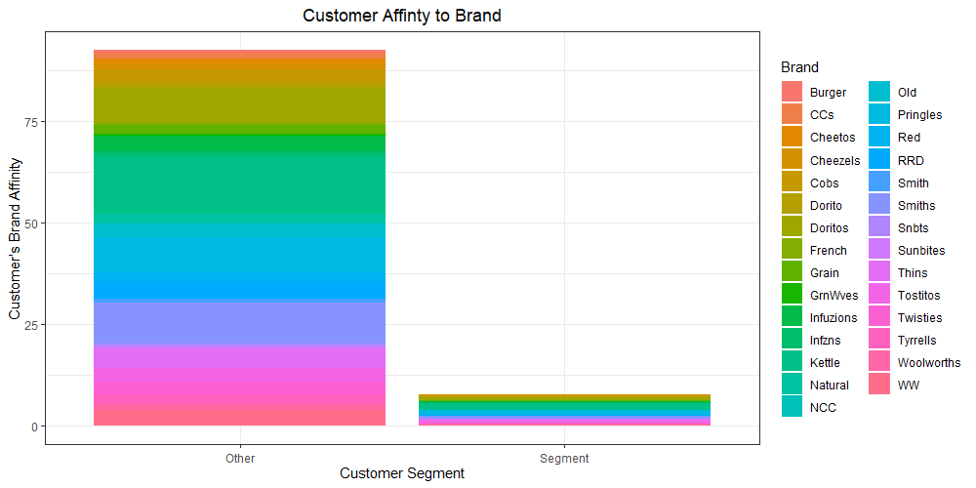
The Category Manager can increase the category’s performance by off-locating some Tyrrells and smaller packs of chips in discretionary space near segments where young singles and couples frequent more often to increase visibility and impulse behavior.

Slide 7
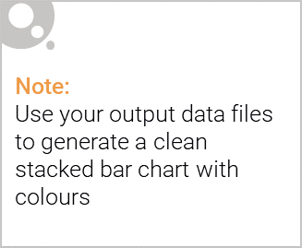
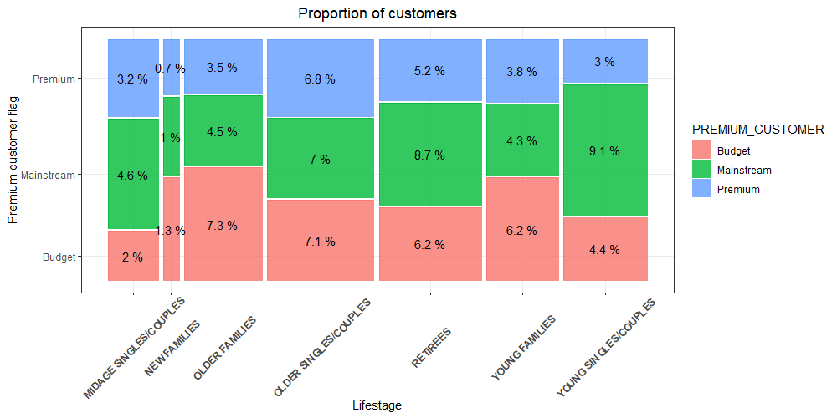
Editable (delete this)
Sales have mainly been due to Budget - older families, Mainstream - young singles/couples, and Mainstream- retirees shoppers, due to the fact that mainstream young singles/couples (9.1%) and retirees (8.7%) are more than other buyers so they tend to spend more on chips.

Slide 8
02
Trial store performance

Slide 9
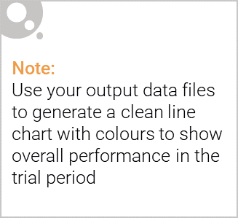
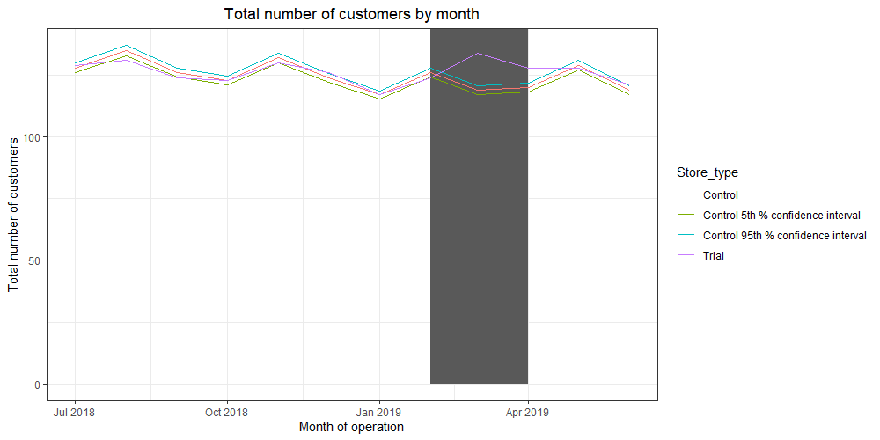
We’ve found control stores 233, 155, 237 for trial stores 77, 86 and 88 respectively. The results for trial stores 77 and 88 during the trial period show a significant difference in at least two of the three trial months but this is not the case for trial store 86

Slide 10
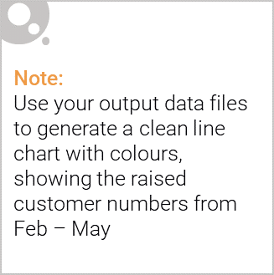
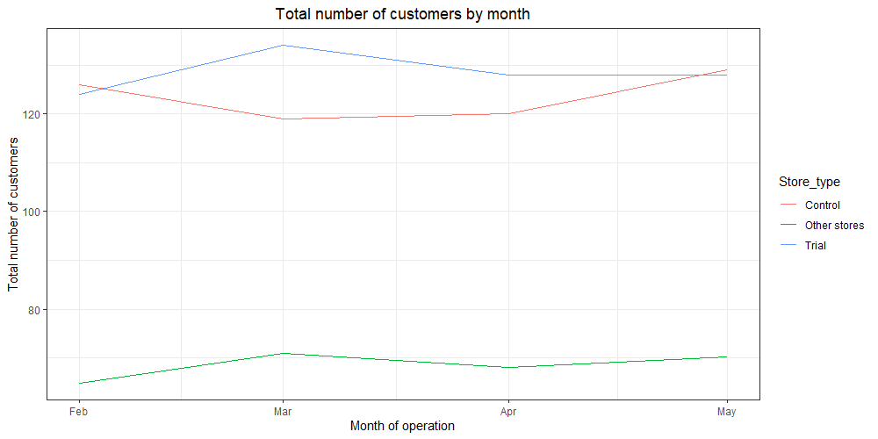
There is a significant increase in sales as shown from the trials since total number of customers in the trial period for the trial store is significantly higher than the control store for two out of three months, which indicates a positive trial effect.

